Slide 1
Lazy Learners

Slide 2
Lazy vs. Eager Learning
Eager learning :
  Given a set of training tuples, constructs a classification model before receiving new (e.g., test) data to classify
  Learned model are being ready and eager to classify unseen tuples
Lazy Learning (e.g., instance-based learning):
    Simply stores training data (or only minor processing) and Lazy learning waits until it is given with a test tuple to do model construction
    Lazy: less time in training but more time in prediction

Slide 3
Lazy vs. Eager Learning
  Lazy method effectively uses a richer hypothesis space since it uses many local linear functions to form an implicit global approximation to the target function
  Eager: must commit to a single hypothesis that covers the entire instance space
  Support incremental learning,computationally expensive and cable of building complex decision spaces.
  Requires efficient storage techniques and parallel hardware

Slide 4
Lazy Learner: Instance-Based Methods
Typical approaches
  k-nearest neighbor approach
    Instances represented as points in a Euclidean space.
  Case-based reasoning
    Uses symbolic representations and knowledge-based inference

Slide 5
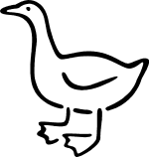
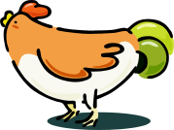


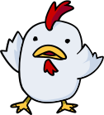

Nearest Neighbor Classifiers
Basic idea:
  If it walks like a duck, quacks like a duck, then it’s probably a duck
Compute Distance
Test Record
Training Records
Choose k of the “nearest” records
Data Mining: Concepts and Techniques

Slide 6
The k-Nearest Neighbor Algorithm
Nearest-Neighbor classifiers based on learning by analogy.
Tuples described by n attributes.
All instances correspond to a point in the n-dimensional space
For an unknown tuple, a k-nearest neighbor classifier searches the pattern space for the k training tuples for identifying the closest tuple.
The k training tuples are the k “nearest neighbors” of the unknown tuple.
“Closeness” defined in terms of distance metric such as Euclidean distance
DIST(x1,x2)=√ ∑ _{i=1..n} (x_{1i}-x_{2i})²

Slide 7
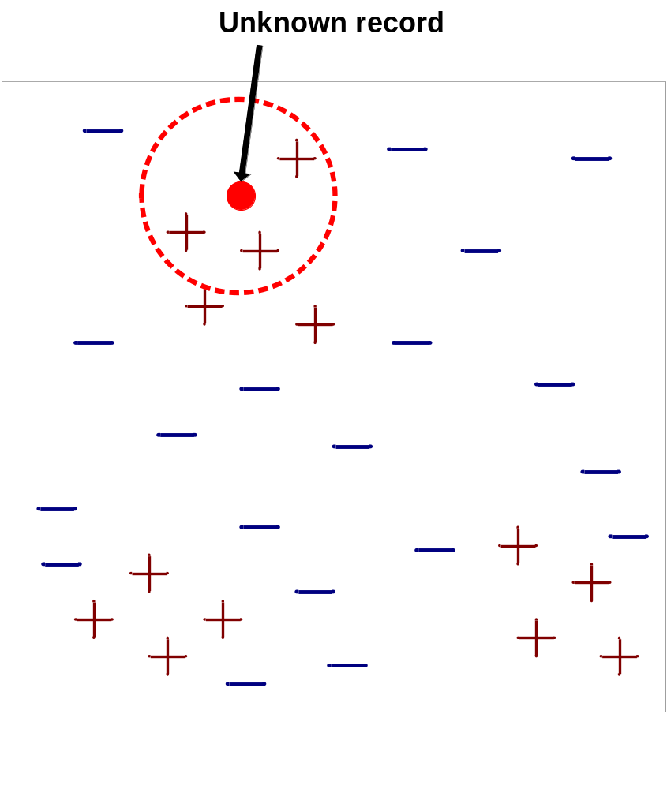
Nearest-Neighbor Classifiers
Requires three things
  The set of stored records
  Distance Metric to compute distance between records
  The value of k, the number of nearest neighbors to retrieve
To classify an unknown record:
  Compute distance to other training records
  Identify k nearest neighbors
  Use class labels of nearest neighbors to determine the class label of unknown record (e.g., by taking majority vote)
Data Mining: Concepts and Techniques

Slide 8

Definition of Nearest Neighbor
How to determine good value for k the number of neighbors?
  The value with minimum error rate is considered
Data Mining: Concepts and Techniques

Slide 9
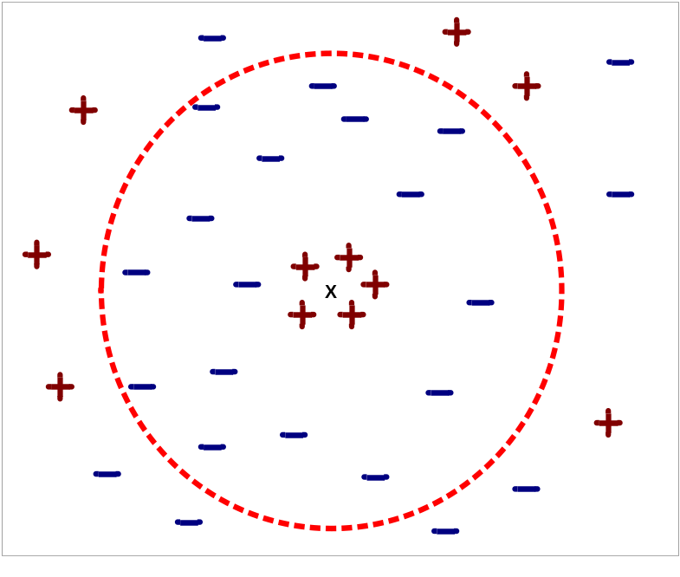
Nearest Neighbor Classification…
Choosing the value of k:
  If k is too small, sensitive to noise points
  If k is too large, neighborhood may include points from other classes
Data Mining: Concepts and Techniques

Slide 10
Nearest Neighbor Classification…
Scaling issues
  Attributes may have to be scaled to prevent distance measures from being dominated by one of the attributes
  Example:
    height of a person may vary from 1.5m to 1.8m
    weight of a person may vary from 90lb to 300lb
  Solution: Normalize the vectors to unit length
    Min-Max normalization is used to transform the numeric attribute.
  For nominal attributes compare the corresponding values if two are equal then difference is zero else difference is 1.
Data Mining: Concepts and Techniques

Slide 11
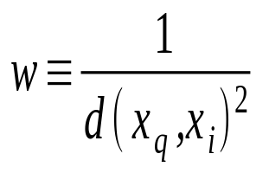
Discussion on the k-NN Algorithm
Distance based comparison suffers from poor accuracy
Distance-weighted nearest neighbor algorithm
  Weight the contribution of each of the k neighbors according to their distance to the query x_{q}
    Give greater weight to closer neighbors
    Robust to noisy data by averaging k-nearest neighbors
Curse of dimensionality: distance between neighbors could be dominated by irrelevant attributes
  To overcome it, eliminate the least relevant attributes

Slide 12
Case-Based Reasoning (CBR)
CBR: Uses a database of problem solutions to solve new problems
Store symbolic description (tuples or cases)—not points in a Euclidean space
Applications: Customer-service (product-related diagnosis), legal ruling, Medical education.
Methodology
  When given a new case to classify, a case-based reasoner will first check if an identical training case exists.
  If one is found, then the accompanying solution to that case.
  If no identical case is found, then the case-based reasoner will search for training cases having components that are similar to those of the new case.

Slide 13
Case-Based Reasoning (CBR)
If cases are represented as graphs, this involves searching for subgraphs that are similar to subgraphs within the new case.
The case-based reasoner tries to combine the solutions of the neighboring training cases to propose a solution for the new case.
The case-based reasoner may employ background knowledge and problem-solving strategies to propose a feasible combined solution.
Challenges
  Find a good similarity metric
  Indexing based on syntactic similarity measure, and when failure, backtracking, and adapting to additional cases

